Slide 1
Exercice
ConstraintLayout

Slide 2
Objectif
Réaliser l’écran suivant avec les contraintes suivantes :
  Pas de layout imbriqué : un seul niveau de layout.
  Affichage adapté pour un écran en paysage.
  Affichage adapté a plusieurs résolutions d’écrans.

Slide 3
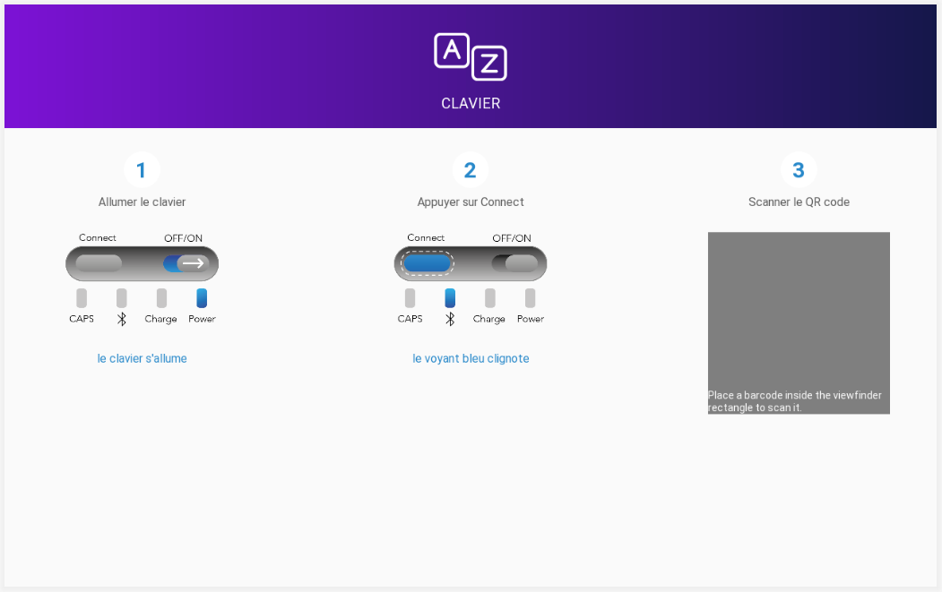
Résultat à obtenir

Slide 4
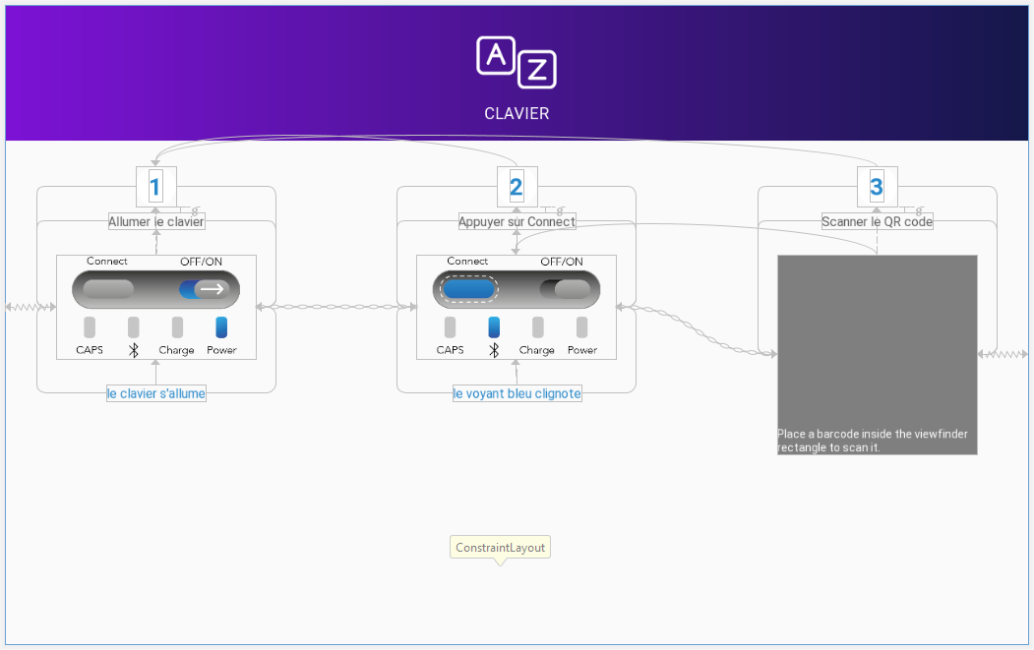
Contraintes
Notes:
Le layout principal :
<?xml version="1.0" encoding="utf-8"?>
<androidx.constraintlayout.widget.ConstraintLayout xmlns:android="http://schemas.android.com/apk/res/android"
xmlns:app="http://schemas.android.com/apk/res-auto"
android:layout_width="match_parent"
android:layout_height="match_parent">
<!--Include the header without unneeded viewgroup-->
<include layout="@layout/header"/>
<ImageView
android:id="@+id/fragment_scan_qr_code_imageView_help_1"
android:layout_width="@dimen/images_help_size_width"
android:layout_height="@dimen/images_help_size_height"
android:layout_marginVertical="@dimen/margin_vertical"
android:layout_marginLeft="@dimen/margin_horizontal"
android:src="@drawable/clavier_1"
app:layout_constraintEnd_toStartOf="@id/fragment_scan_qr_code_imageView_help_2"
app:layout_constraintHorizontal_chainStyle="spread_inside"
app:layout_constraintStart_toStartOf="parent"
app:layout_constraintTop_toBottomOf="@id/fragment_scan_qr_code_textView_label_1" />
<ImageView
android:id="@+id/fragment_scan_qr_code_imageView_help_2"
android:layout_width="@dimen/images_help_size_width"
android:layout_height="@dimen/images_help_size_height"
android:layout_marginVertical="@dimen/margin_vertical"
android:src="@drawable/clavier_2"
app:layout_constraintEnd_toStartOf="@id/fragment_scan_qr_code_decoratedBarcodeView_help_3"
app:layout_constraintStart_toEndOf="@id/fragment_scan_qr_code_imageView_help_1"
app:layout_constraintTop_toBottomOf="@id/fragment_scan_qr_code_textView_number_label_2" />
<com.journeyapps.barcodescanner.DecoratedBarcodeView
android:id="@+id/fragment_scan_qr_code_decoratedBarcodeView_help_3"
android:layout_width="@dimen/images_help_size_width"
android:layout_height="@dimen/images_help_size_width"
android:layout_marginRight="@dimen/margin_horizontal"
app:layout_constraintEnd_toEndOf="parent"
app:layout_constraintStart_toEndOf="@id/fragment_scan_qr_code_imageView_help_2"
app:layout_constraintTop_toTopOf="@id/fragment_scan_qr_code_imageView_help_2"
app:zxing_preview_scaling_strategy="centerCrop"
app:zxing_use_texture_view="false" />
<androidx.cardview.widget.CardView
android:id="@+id/fragment_bt_connected_cardView_number_header_1"
android:layout_width="@dimen/header_number_round_size"
android:layout_height="@dimen/header_number_round_size"
android:layout_marginTop="@dimen/margin_vertical"
app:cardCornerRadius="@dimen/header_number_round_radius"
app:cardElevation="@dimen/header_number_round_elevation"
app:layout_constraintLeft_toLeftOf="@id/fragment_scan_qr_code_imageView_help_1"
app:layout_constraintRight_toRightOf="@id/fragment_scan_qr_code_imageView_help_1"
app:layout_constraintTop_toBottomOf="@+id/guideline_header">
<TextView
style="@style/Number"
android:layout_width="wrap_content"
android:layout_height="wrap_content"
android:layout_gravity="center"
android:text="1" />
</androidx.cardview.widget.CardView>
<androidx.cardview.widget.CardView
android:id="@+id/fragment_scan_qr_code_cardView_number_header_2"
android:layout_width="@dimen/header_number_round_size"
android:layout_height="@dimen/header_number_round_size"
app:cardCornerRadius="@dimen/header_number_round_radius"
app:cardElevation="@dimen/header_number_round_elevation"
app:layout_constraintLeft_toLeftOf="@id/fragment_scan_qr_code_imageView_help_2"
app:layout_constraintRight_toRightOf="@id/fragment_scan_qr_code_imageView_help_2"
app:layout_constraintTop_toTopOf="@id/fragment_bt_connected_cardView_number_header_1">
<TextView
style="@style/Number"
android:layout_width="wrap_content"
android:layout_height="wrap_content"
android:layout_gravity="center"
android:text="2" />
</androidx.cardview.widget.CardView>
<androidx.cardview.widget.CardView
android:id="@+id/fragment_scan_qr_code_cardView_number_header_3"
android:layout_width="@dimen/header_number_round_size"
android:layout_height="@dimen/header_number_round_size"
app:cardCornerRadius="@dimen/header_number_round_radius"
app:cardElevation="@dimen/header_number_round_elevation"
app:layout_constraintLeft_toLeftOf="@id/fragment_scan_qr_code_decoratedBarcodeView_help_3"
app:layout_constraintRight_toRightOf="@id/fragment_scan_qr_code_decoratedBarcodeView_help_3"
app:layout_constraintTop_toTopOf="@id/fragment_bt_connected_cardView_number_header_1">
<TextView
android:id="@+id/fragment_scan_qr_code_textView_number_header_3"
style="@style/Number"
android:layout_width="wrap_content"
android:layout_height="wrap_content"
android:layout_gravity="center"
android:text="3" />
</androidx.cardview.widget.CardView>
<TextView
android:id="@+id/fragment_scan_qr_code_textView_label_1"
style="@style/Label"
android:layout_width="wrap_content"
android:layout_height="wrap_content"
android:layout_marginTop="@dimen/margin_vertical_small"
android:text="@string/scan_qr_code_to_connect_step1"
app:layout_constraintLeft_toLeftOf="@id/fragment_scan_qr_code_imageView_help_1"
app:layout_constraintRight_toRightOf="@id/fragment_scan_qr_code_imageView_help_1"
app:layout_constraintTop_toBottomOf="@id/fragment_bt_connected_cardView_number_header_1" />
<TextView
android:id="@+id/fragment_scan_qr_code_textView_detail_1"
style="@style/Detail"
android:layout_width="wrap_content"
android:layout_height="wrap_content"
android:layout_marginVertical="@dimen/margin_vertical"
android:text="@string/scan_qr_code_to_connect_step1_details"
app:layout_constraintLeft_toLeftOf="@id/fragment_scan_qr_code_imageView_help_1"
app:layout_constraintRight_toRightOf="@id/fragment_scan_qr_code_imageView_help_1"
app:layout_constraintTop_toBottomOf="@id/fragment_scan_qr_code_imageView_help_1" />
<TextView
android:id="@+id/fragment_scan_qr_code_textView_number_label_2"
style="@style/Label"
android:layout_width="wrap_content"
android:layout_height="wrap_content"
android:layout_marginTop="@dimen/margin_vertical_small"
android:text="@string/scan_qr_code_to_connect_step2"
app:layout_constraintLeft_toLeftOf="@id/fragment_scan_qr_code_imageView_help_2"
app:layout_constraintRight_toRightOf="@id/fragment_scan_qr_code_imageView_help_2"
app:layout_constraintTop_toBottomOf="@id/fragment_scan_qr_code_cardView_number_header_2" />
<TextView
android:id="@+id/fragment_scan_qr_code_textView_detail_2"
style="@style/Detail"
android:layout_width="wrap_content"
android:layout_height="wrap_content"
android:layout_marginVertical="@dimen/margin_vertical"
android:text="@string/scan_qr_code_to_connect_step2_details"
app:layout_constraintLeft_toLeftOf="@id/fragment_scan_qr_code_imageView_help_2"
app:layout_constraintRight_toRightOf="@id/fragment_scan_qr_code_imageView_help_2"
app:layout_constraintTop_toBottomOf="@id/fragment_scan_qr_code_imageView_help_2" />
<TextView
android:id="@+id/fragment_scan_qr_code_textView_number_label_3"
style="@style/Label"
android:layout_width="wrap_content"
android:layout_height="wrap_content"
android:layout_marginTop="@dimen/margin_vertical_small"
android:text="@string/scan_qr_code_to_connect_step3"
app:layout_constraintLeft_toLeftOf="@id/fragment_scan_qr_code_decoratedBarcodeView_help_3"
app:layout_constraintRight_toRightOf="@id/fragment_scan_qr_code_decoratedBarcodeView_help_3"
app:layout_constraintTop_toBottomOf="@id/fragment_scan_qr_code_cardView_number_header_3" />
</androidx.constraintlayout.widget.ConstraintLayout>
Le header :
<?xml version="1.0" encoding="utf-8"?>
<merge xmlns:android="http://schemas.android.com/apk/res/android"
xmlns:app="http://schemas.android.com/apk/res-auto">
<View
android:id="@+id/header_view_header_background"
android:layout_width="0dp"
android:layout_height="0dp"
android:background="@drawable/header_background"
app:layout_constraintBottom_toBottomOf="@+id/guideline_header"
app:layout_constraintEnd_toEndOf="parent"
app:layout_constraintStart_toStartOf="parent"
app:layout_constraintTop_toTopOf="parent" />
<ImageView
android:id="@+id/header_imageView_header_logo"
android:layout_width="@dimen/logo_header_size"
android:layout_height="@dimen/logo_header_size"
android:src="@drawable/ic_logo_header"
app:layout_constraintBottom_toTopOf="@+id/header_textView_header"
app:layout_constraintEnd_toEndOf="parent"
app:layout_constraintStart_toStartOf="parent"
app:layout_constraintTop_toTopOf="parent"
app:layout_constraintVertical_chainStyle="packed" />
<TextView
android:id="@+id/header_textView_header"
style="@style/Header"
android:layout_width="wrap_content"
android:layout_height="wrap_content"
android:text="@string/app_name"
app:layout_constraintBottom_toBottomOf="@+id/guideline_header"
app:layout_constraintEnd_toEndOf="parent"
app:layout_constraintStart_toStartOf="parent"
app:layout_constraintTop_toBottomOf="@+id/header_imageView_header_logo" />
<androidx.constraintlayout.widget.Guideline
android:id="@+id/guideline_header"
android:layout_width="wrap_content"
android:layout_height="wrap_content"
android:orientation="horizontal"
app:layout_constraintGuide_begin="@dimen/header_size" />
</merge>
Les styles :
<style name="Header" parent="AppTheme">
<item name="android:textAllCaps">true</item>
<item name="android:textSize">@dimen/header_text_size</item>
<item name="android:textColor">@color/header_text</item>
</style>
<style name="Number" parent="AppTheme">
<item name="android:textStyle">bold</item>
<item name="android:textSize">@dimen/header_number_text_size</item>
<item name="android:textColor">@color/header_number</item>
</style>
<style name="Label" parent="AppTheme">
<item name="android:textSize">@dimen/label_text_size</item>
<item name="android:gravity">center_horizontal</item>
<item name="android:textColor">@color/label</item>
</style>
<style name="Detail" parent="AppTheme">
<item name="android:gravity">center_horizontal</item>
<item name="android:textSize">@dimen/label_detail_text_size</item>
<item name="android:textColor">@color/label_detail</item>
</style>
Colors :
<color name="header_end">#141749</color>
<color name="header_start">#7b12d4</color>
<color name="header_text">#ffffff</color>
<color name="header_number">#2989ca</color>
<color name="label">#5b5b5b</color>
<color name="label_detail">#2989ca</color>
Drawable : @drawable/header_background
<?xml version="1.0" encoding="UTF-8"?>
<shape xmlns:android="http://schemas.android.com/apk/res/android"
android:shape="rectangle">
<gradient
android:angle="0"
android:endColor="@color/header_end"
android:startColor="@color/header_start"
android:type="linear" />
<corners android:radius="0dp" />
</shape>
Dimens :
<dimen name="header_size">170dp</dimen>
<dimen name="logo_header_size">100dp</dimen>
<dimen name="images_help_size_width">250dp</dimen>
<dimen name="images_help_size_height">130dp</dimen>
<dimen name="header_text_size">20sp</dimen>
<dimen name="header_number_round_size">50dp</dimen>
<!--Should be half the previous size-->
<dimen name="header_number_round_radius">25dp</dimen>
<dimen name="header_number_round_elevation">4dp</dimen>
<dimen name="header_number_text_size">30sp</dimen>
<dimen name="label_text_size">16sp</dimen>
<dimen name="label_detail_text_size">16sp</dimen>
<dimen name="label_detail_big_text_size">18sp</dimen>
<dimen name="margin_vertical">32dp</dimen>
<dimen name="margin_vertical_small">8dp</dimen>
<dimen name="margin_horizontal">64dp</dimen>

